Slide 1
Ratios in Context
Year 11 Mathematics

Slide 2
Dot Points
2.3.5 Determine the ratio of two quantities in context
2.3.6 Divide a quantity in a given ratio, for example, share $12 in the ratio 1 to 2
2.3.7 Use ratio to describe simple scales

Slide 3

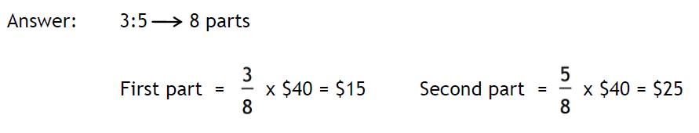
24
7
30
Date: /9/2018
Ratios in Context
EQ – How do we solve problems using ratios?
Example
How do I divide a quantity in a given ratio, for example?

Slide 4
Task

Slide 5
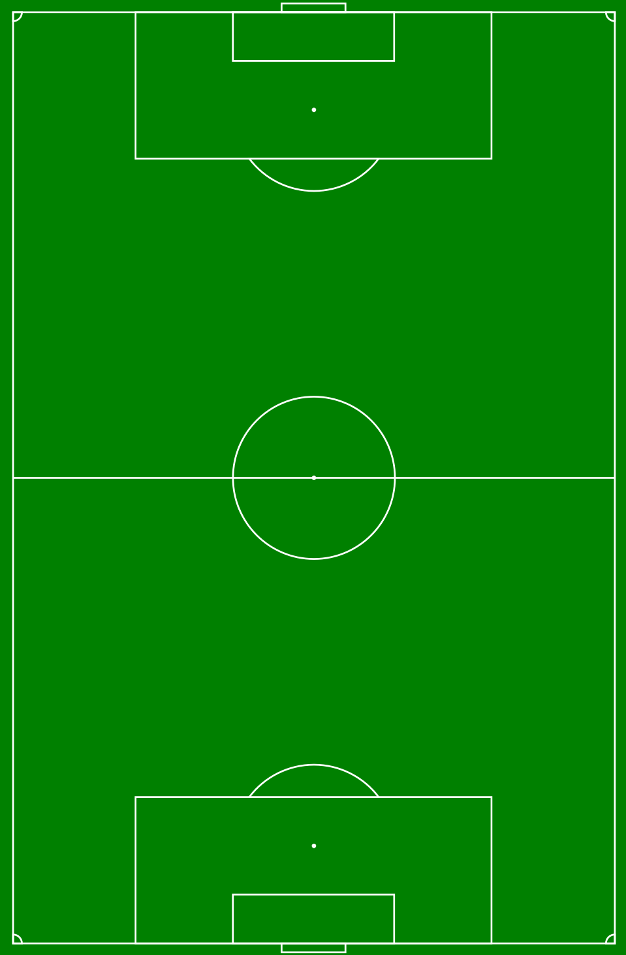








24
7
30
Date: /9/2018
Ratios in Context
EQ – How do we solve problems using ratios?
Example
How do I describe scales using ratios?
A soccer pitch is 100m long and 70m wide. A scale diagram of the pitch is drawn using the scale 1:2000.
The scale factor for the diagram is 2000.
Calculating the drawn length of soccer pitch
$$Drawn length=Actual length÷scale factor$$
$$=100m÷2000$$
$$=0.05m$$
$$=5cm$$
Calculating the drawn width of soccer pitch
$$Drawn length=Actual width÷scale factor$$
$$=70m÷2000$$
$$=0.035m$$
$$=3.5cm$$

Slide 6
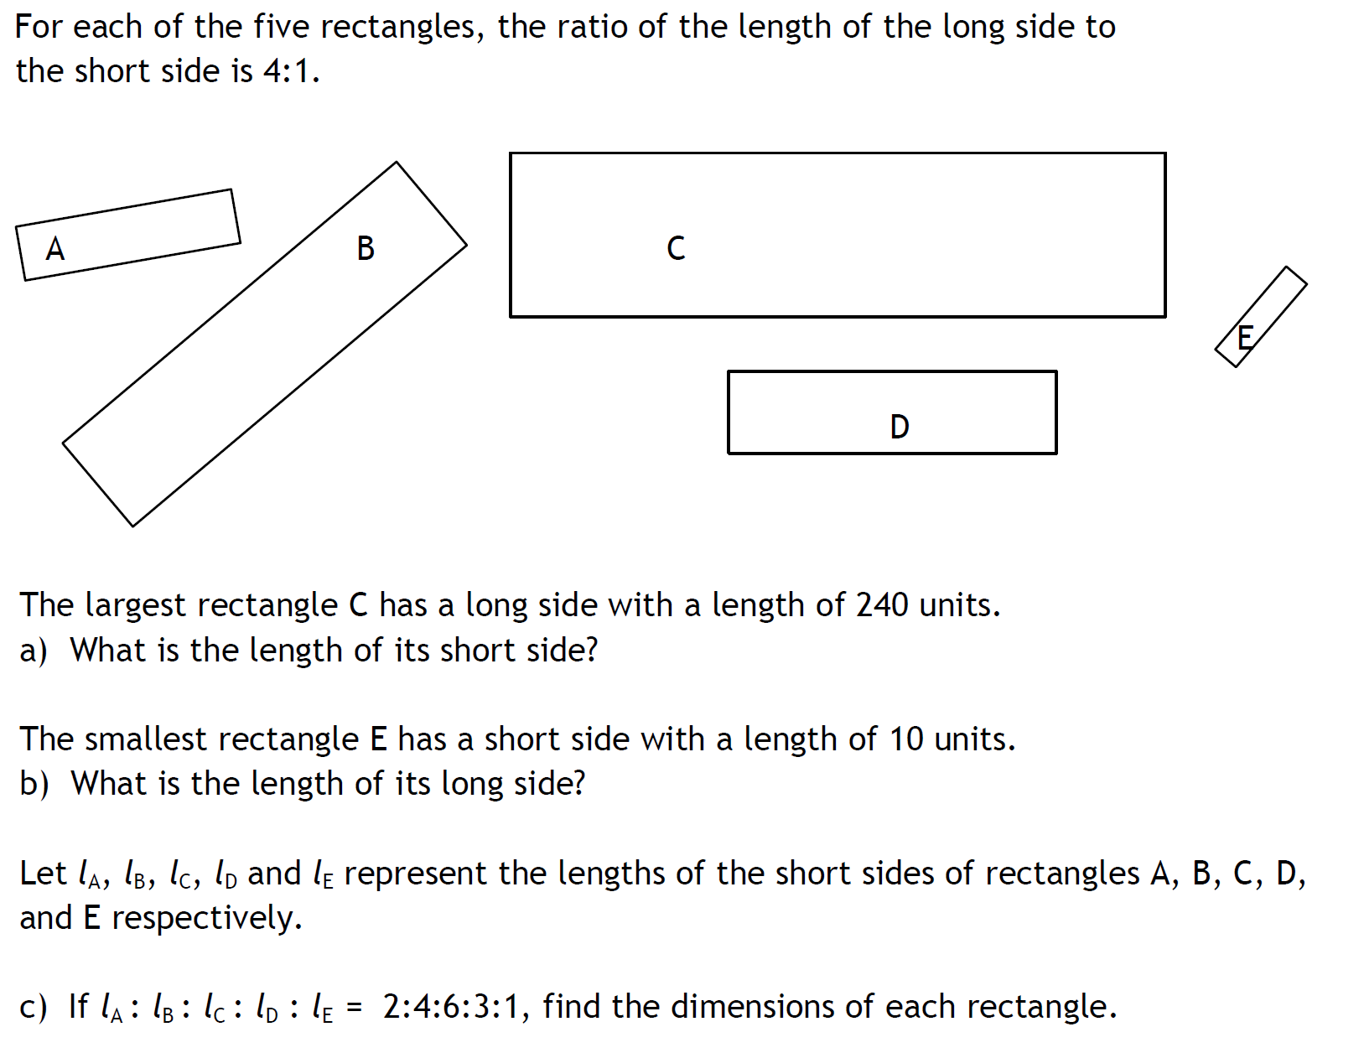
Task

Slide 7
Task
Complete the Ratios in Context Worksheet

